Slide 2
Everyone wants to make videogames!

Slide 3
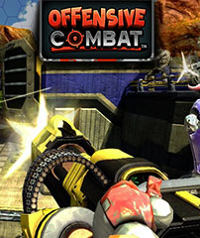
Portfolio Work

Slide 4
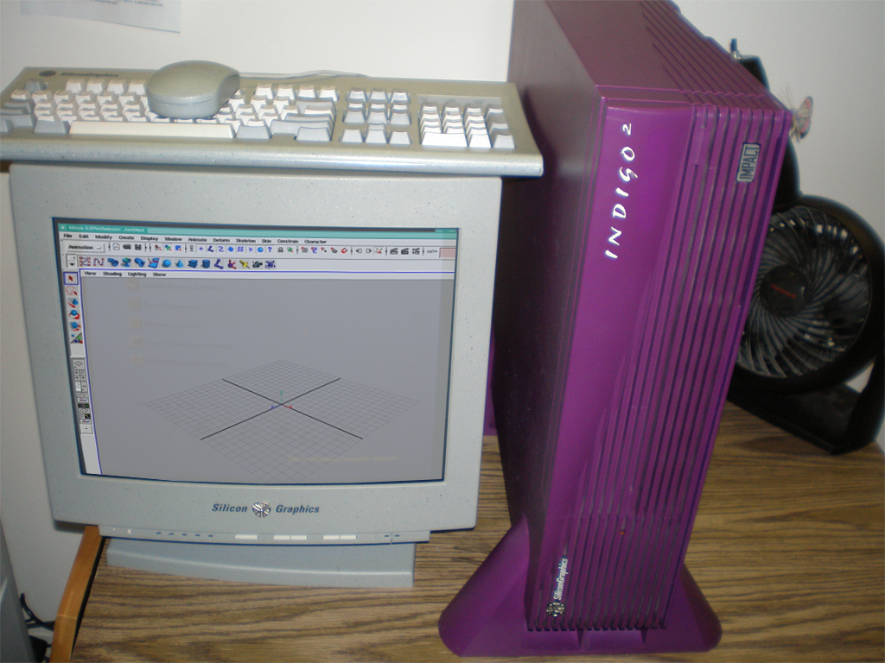
3D Animation track, dynamics & particles in Maya 4 on student films. Graduated from RIT, 2002
3D Artist | V-22 Opsrey Training
Game Tester | Merscom Interactive
Environment Artist | Mid Carolina Media
Level Designer | N-Fusion Interactive
Level Designer | Gearbox Software
FX Artist | BioWare Austin
FX Artist | UTV True Games
FX Artist | KingsIsle Entertainment
FX Artist | U4AI Games
250 MHz Processor
256 MB Memory
4 MB of texture memory IMPACT Graphics Card

Slide 5
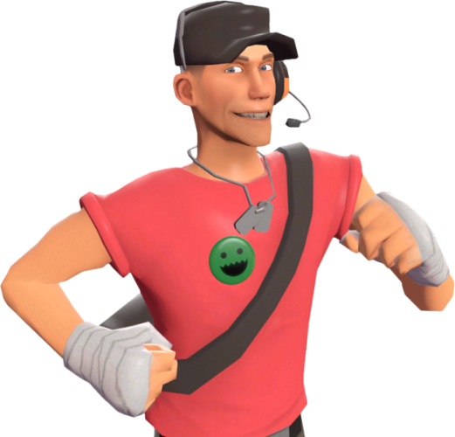
General positions usually available
Concept Artist
Environment Modeler
Character Modeler
Level Designer / Scripter
Animator
FX Artist
User lnterface Artist
Tech Artist
Engineers / Programmers
Producers

Slide 6
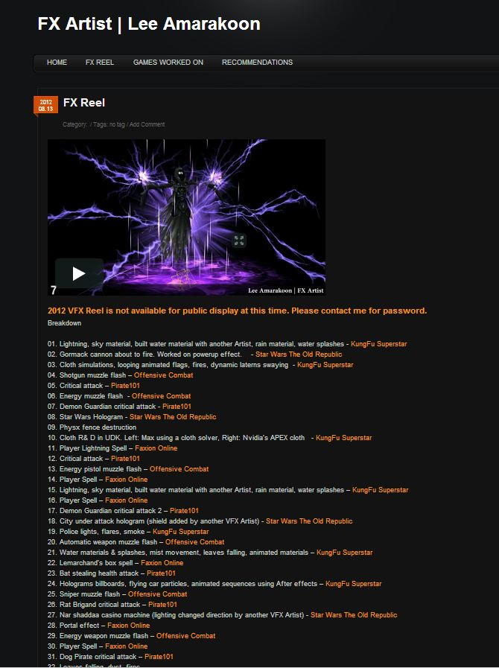
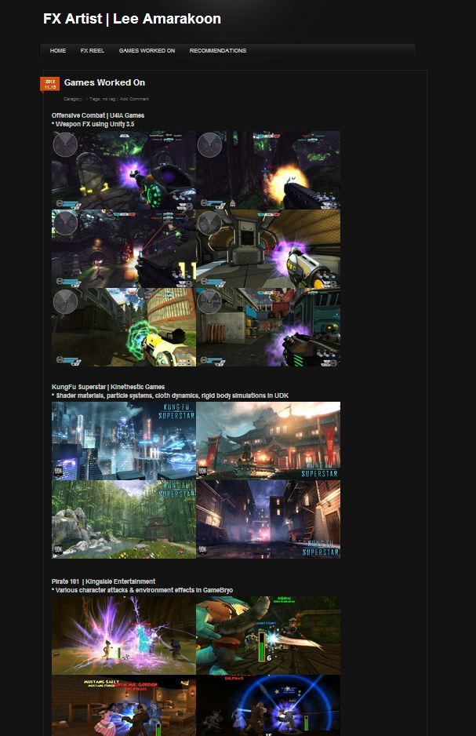
How to make you standout
Resume
Portfolio
Website
Demo reel

Slide 7
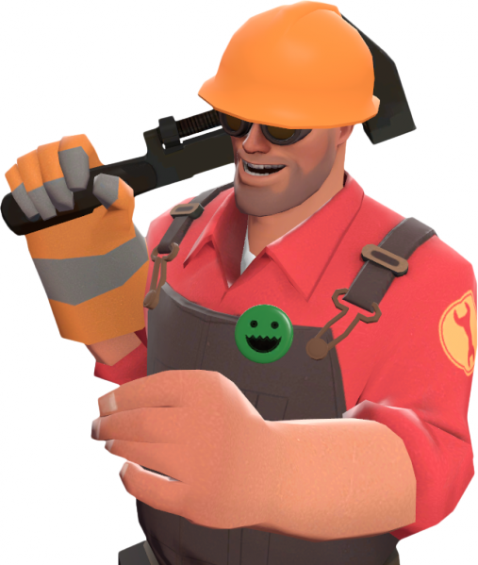
Portfolio | Resume
Keep the resume clean and easy to read
HR manager / Art Director friendly
Short descriptions, what you did. Was it a collaboration?
Important to include game mods, shows you can work in a team environment. Your role on the Mod?
Education goes last not first. Experience is key.
Relevant software experience, skip adding MS Word =)
Name, phone number, email in the resume header, website if its ready

Slide 8
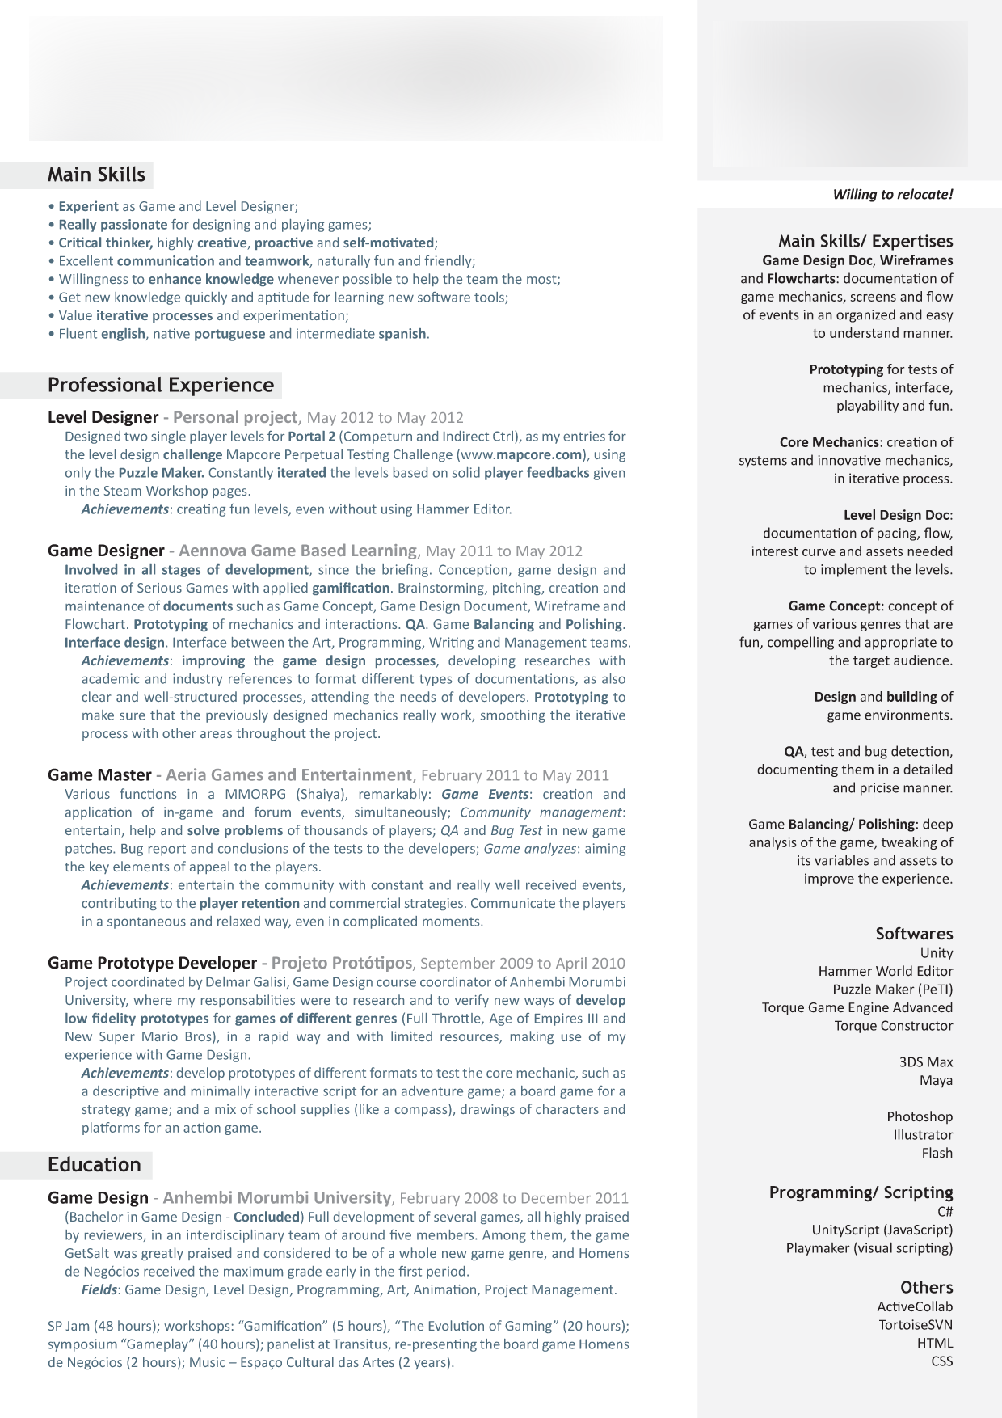
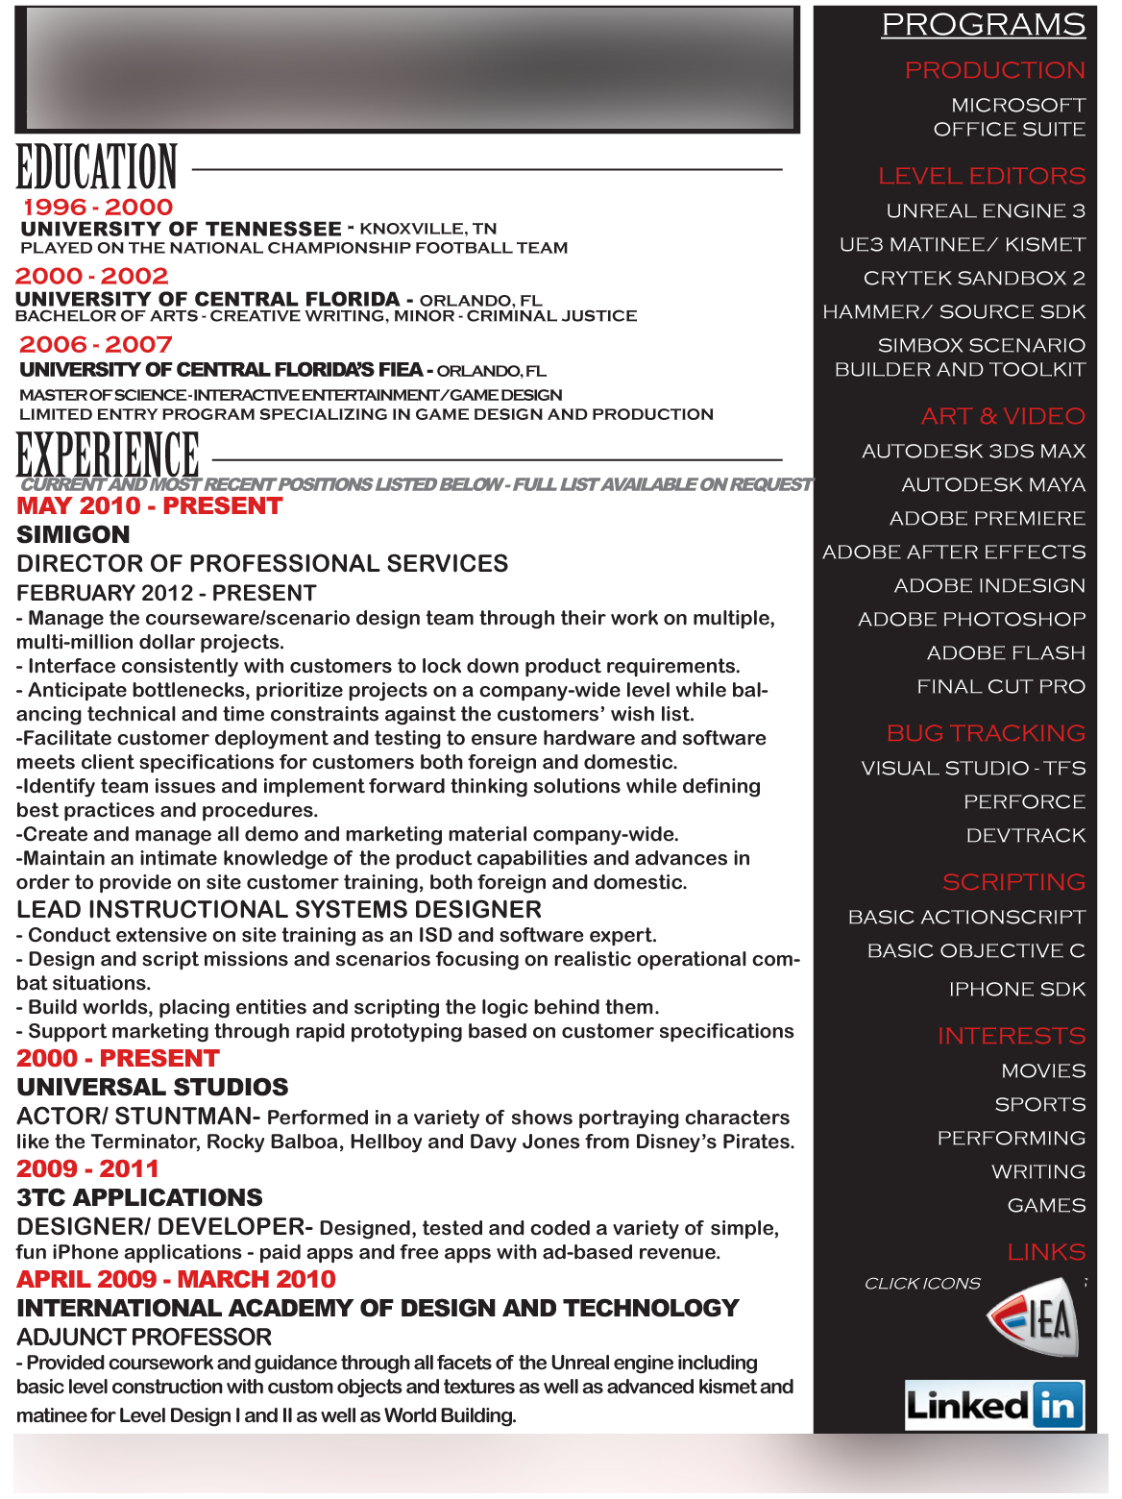
Resumes jammed with text = bad

Slide 9
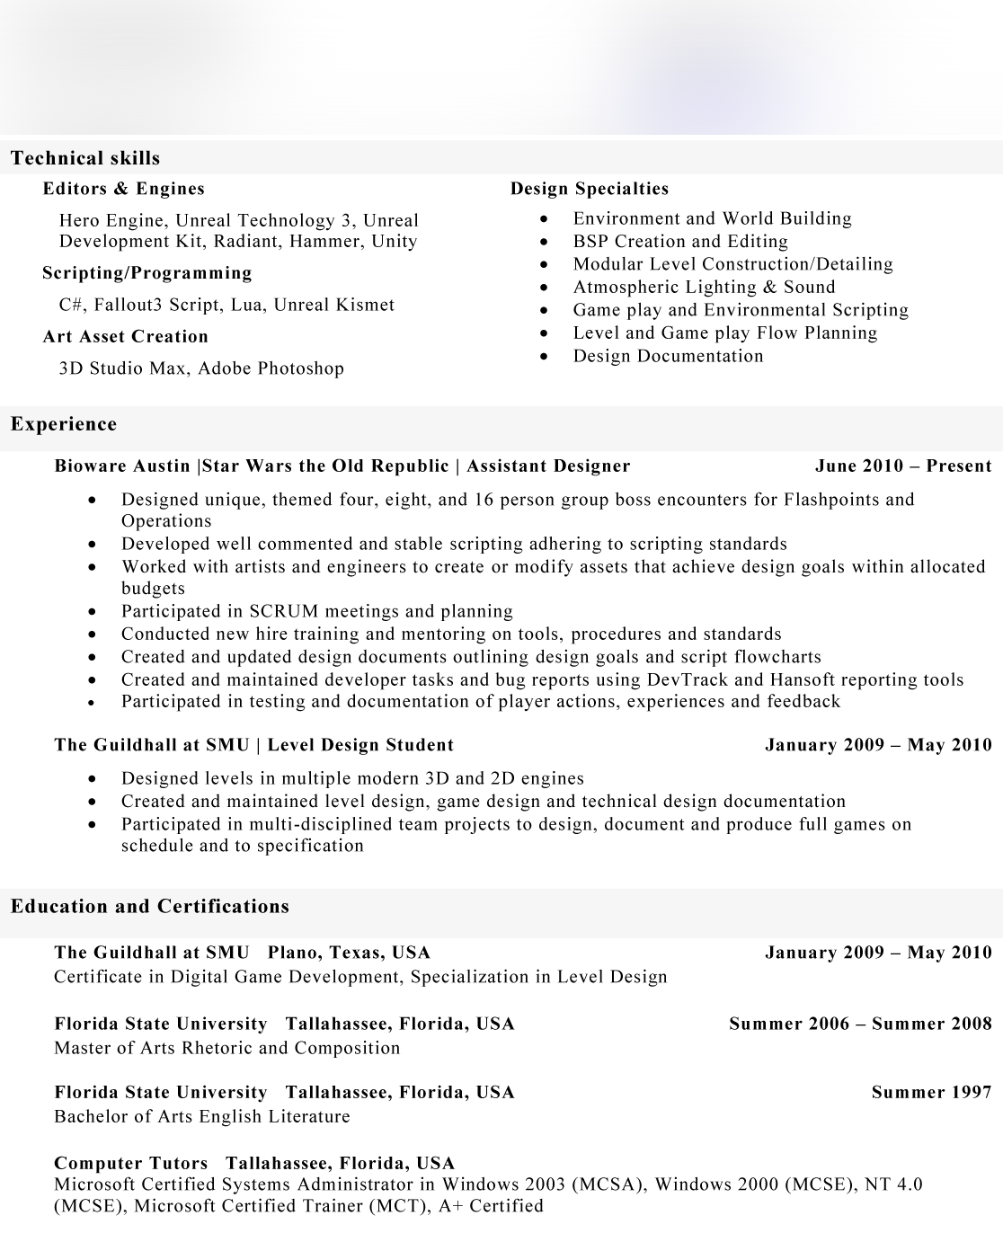
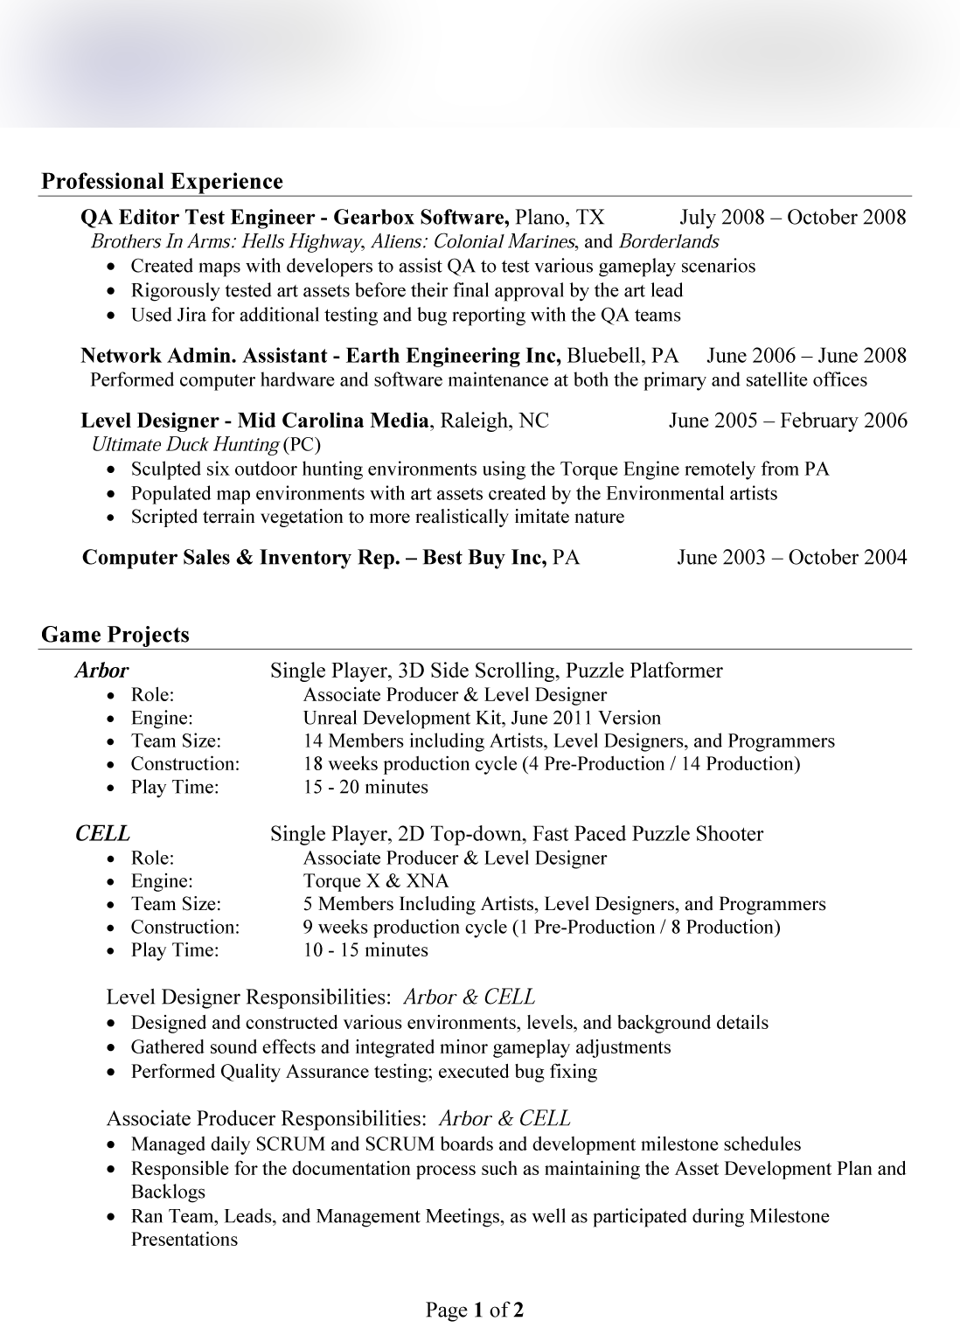
Resumes easy to read = Good

Slide 10
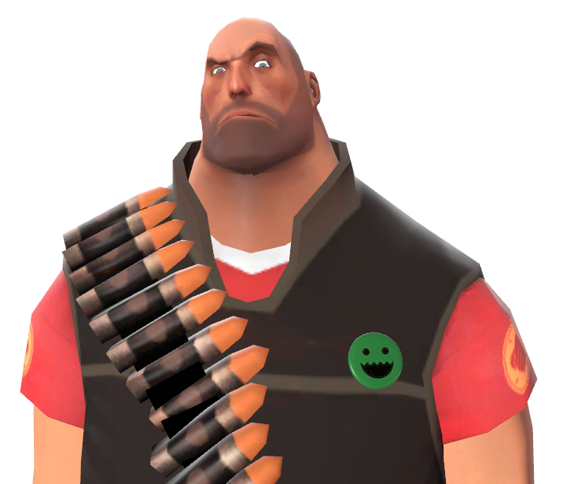
What tools are good to know?
Zbrush 3dsmax Maya MotionBuilder
?

Slide 11
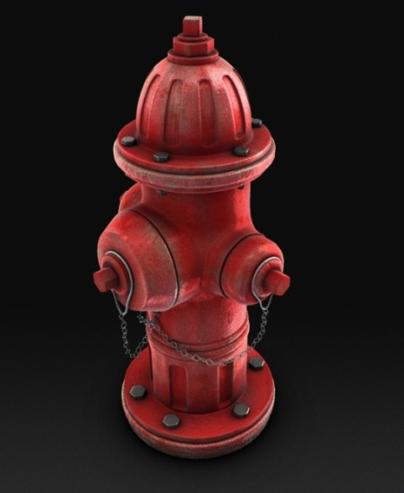
Portfolio | Website
Include your best work with a strong focus on art samples that demonstrates your capability for the position you're applying to.
Include only your best work! Less is more. 10-15 strong images are plenty. No WIP on the site.
List what you did on each image even if you did it all (concept, modeling, texturing, lighting, etc.)
If starting out, consider creating just one scrollable page with your best portfolio pieces on it.
Put your name and contact info on every page and image.
Attention to presentation. Good presentation can make a mediocre asset look fantastic!
Don't email a 50MB zip file. Websites are best.

Slide 12
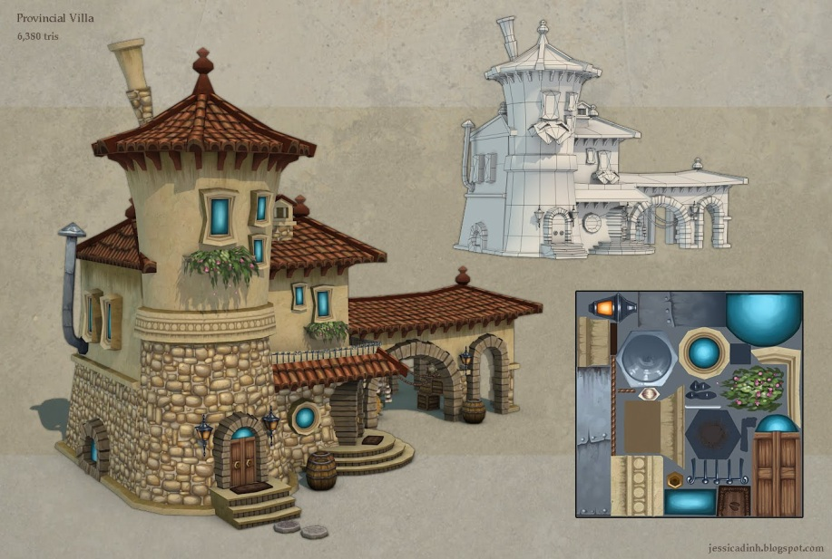
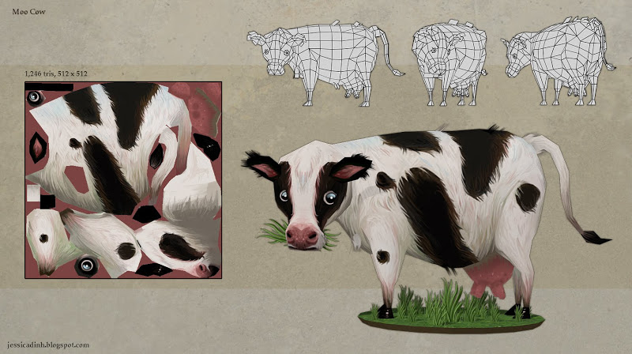
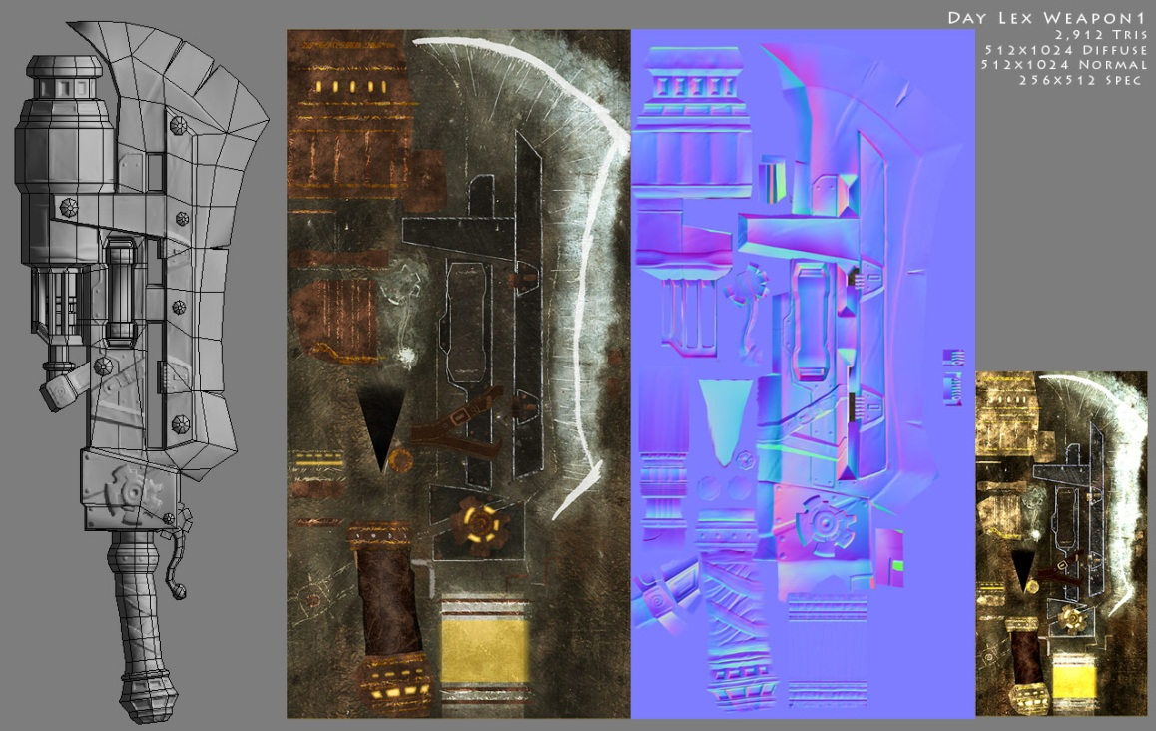
Portfolio | Environments/Props

Slide 13
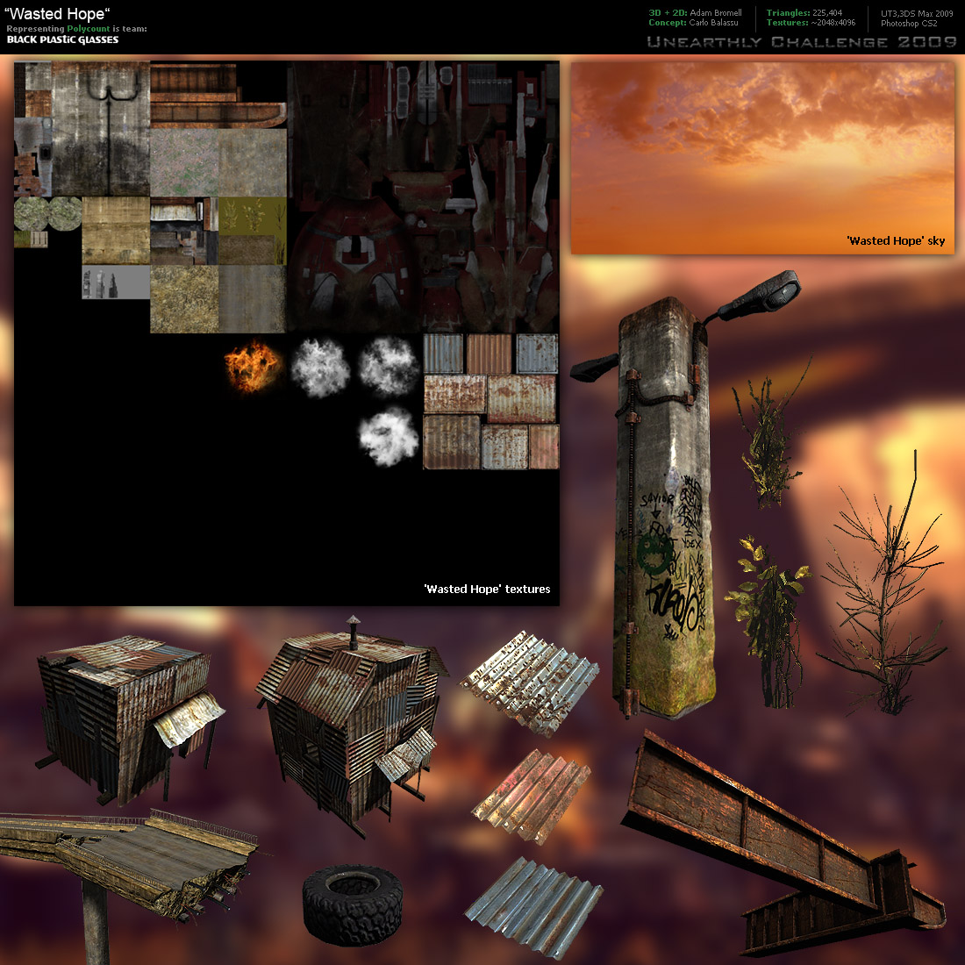
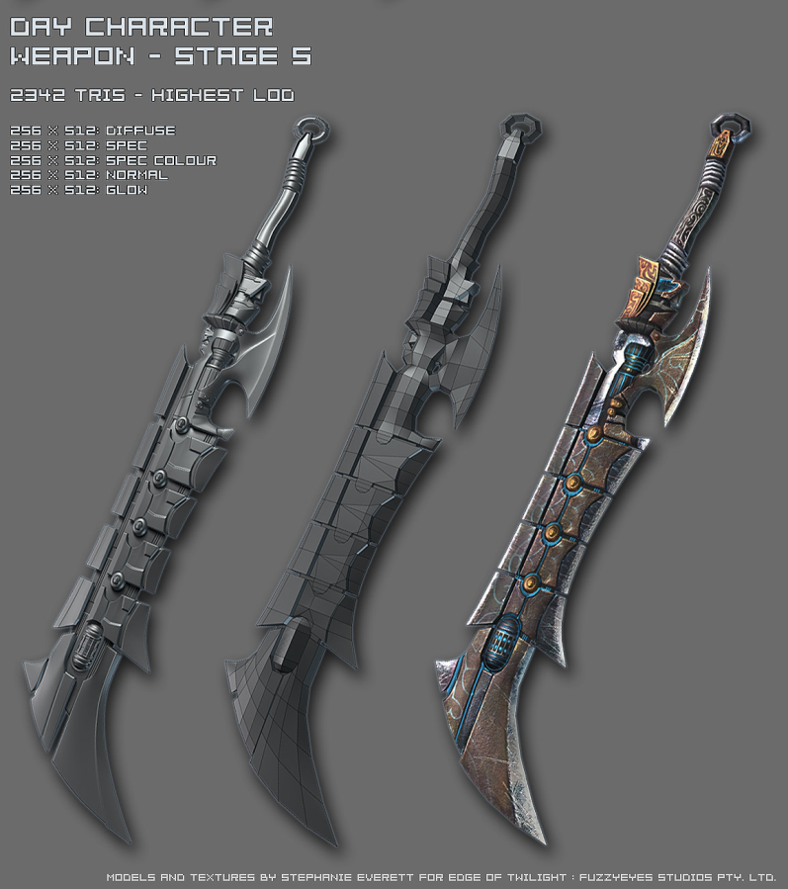
Portfolio | Environments/Props

Slide 14
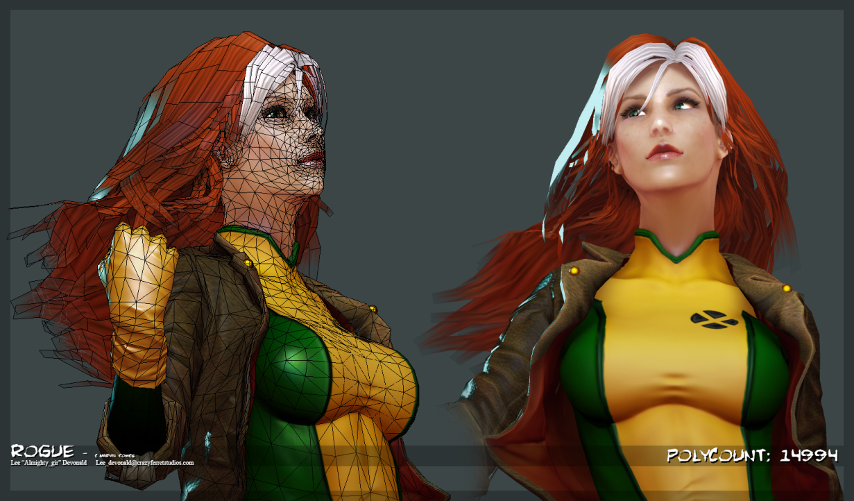
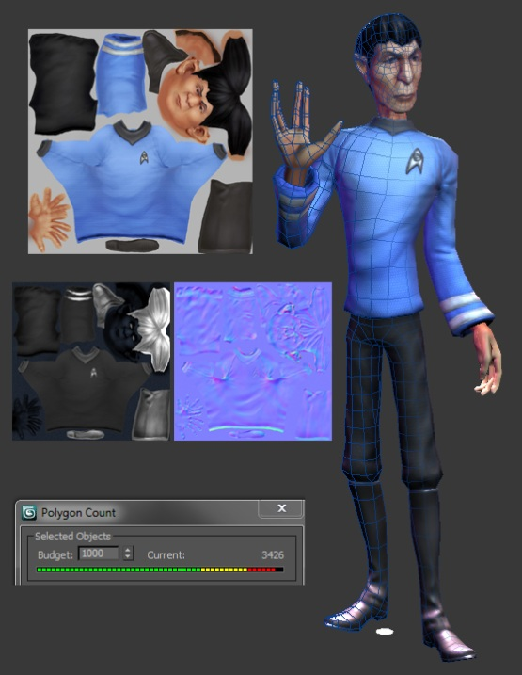
Portfolio | Characters

Slide 15
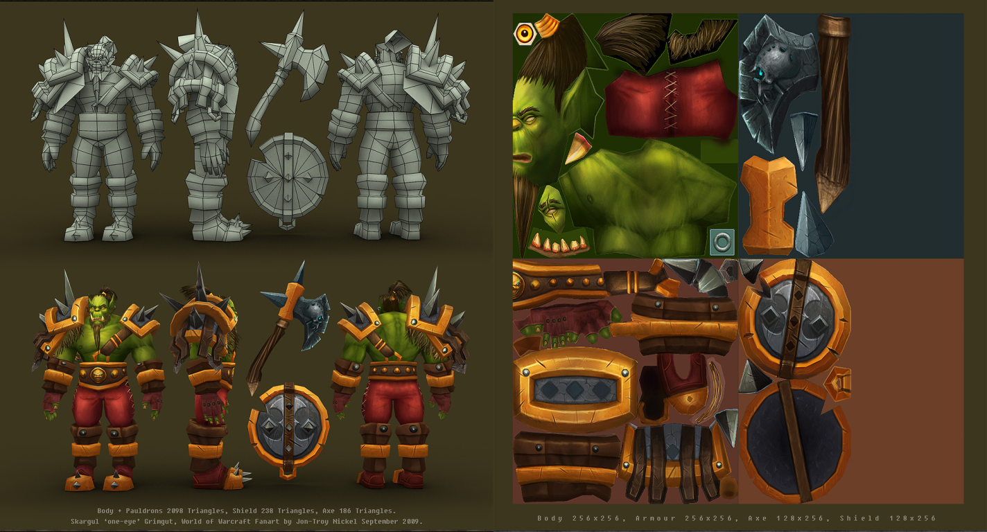
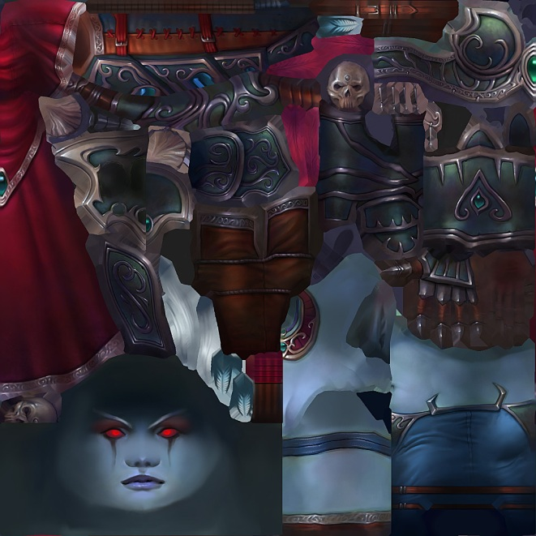
Portfolio | Characters

Slide 16
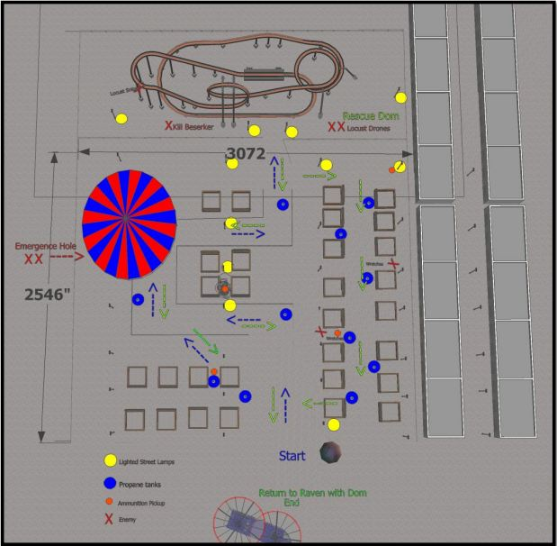
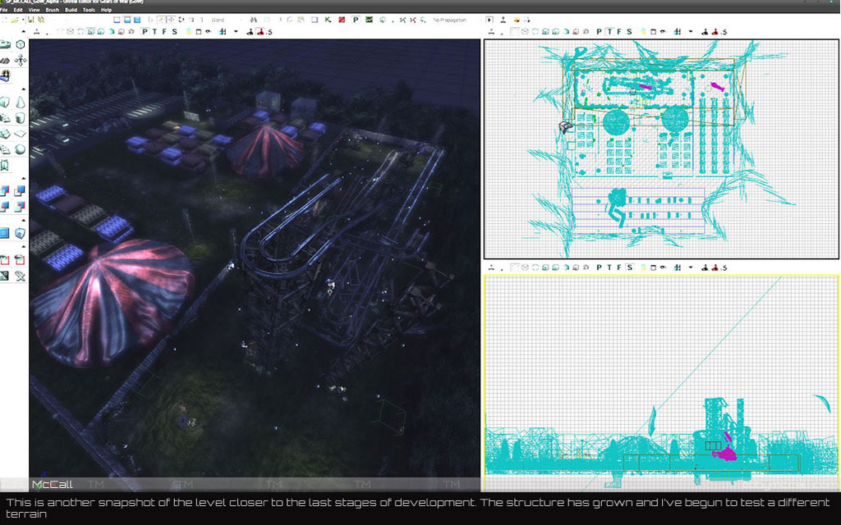
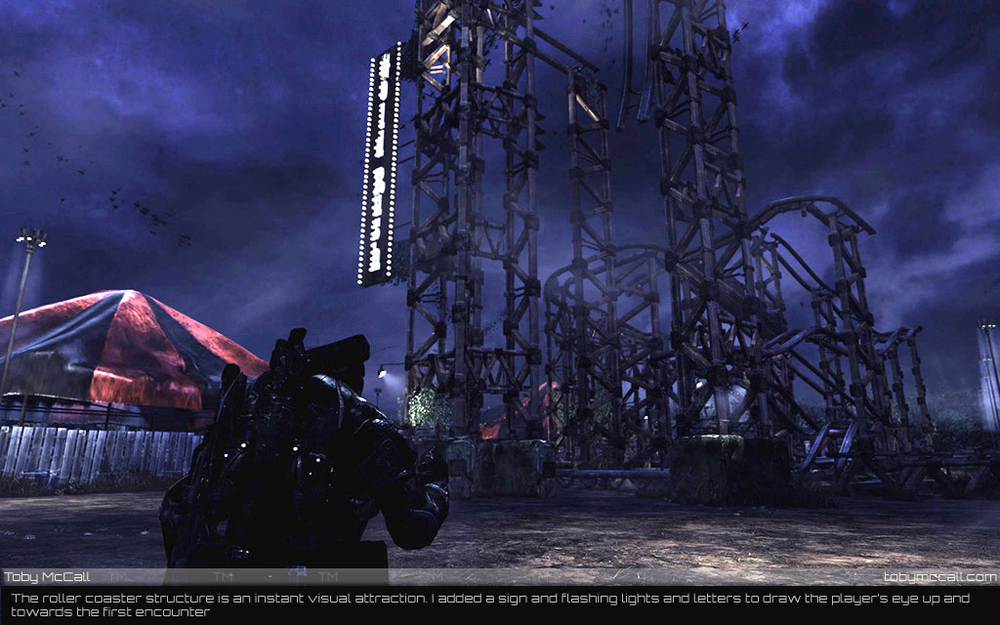
Portfolio | Designer

Slide 17
Portfolio | Demo Reel
Keep the length to a max of 2 mins.
Don’t spin logo
Keep your name up for at least 5 seconds
Avoid using offensive music, classical is safe
Include textures, model info, wireframes.
Label animations, run cycle, grab, throw, etc.
Vimeo.com is better than YouTube for video presentations.

Slide 18
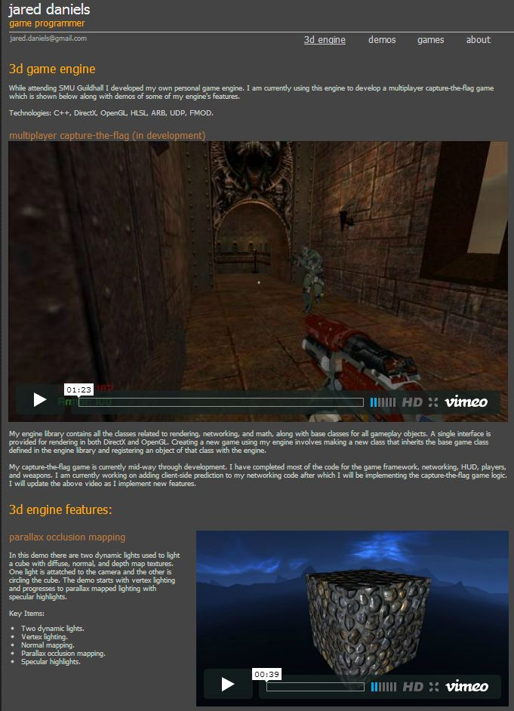
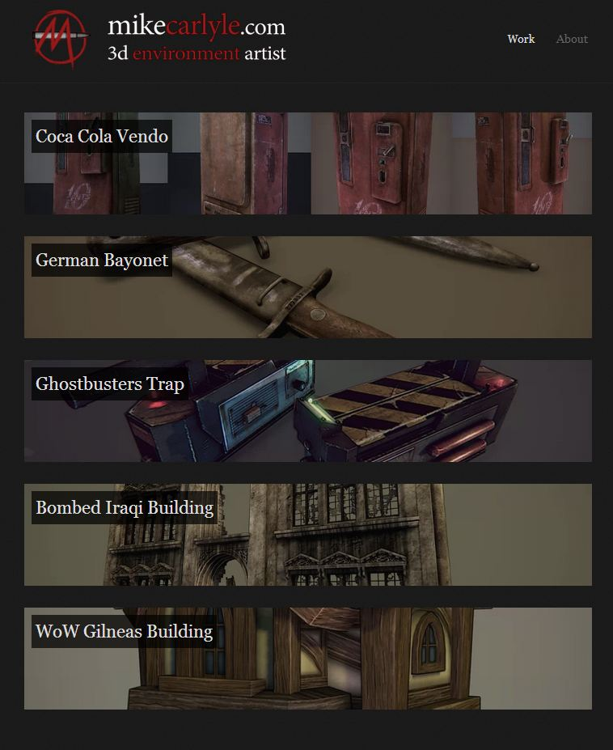
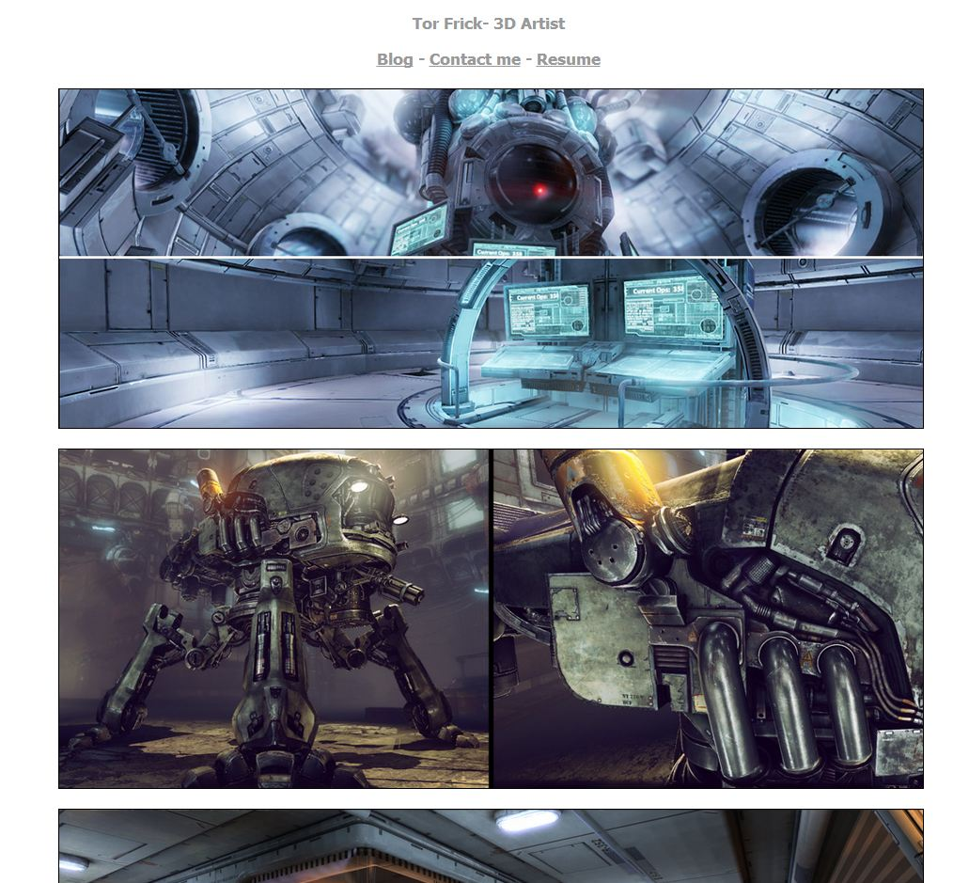
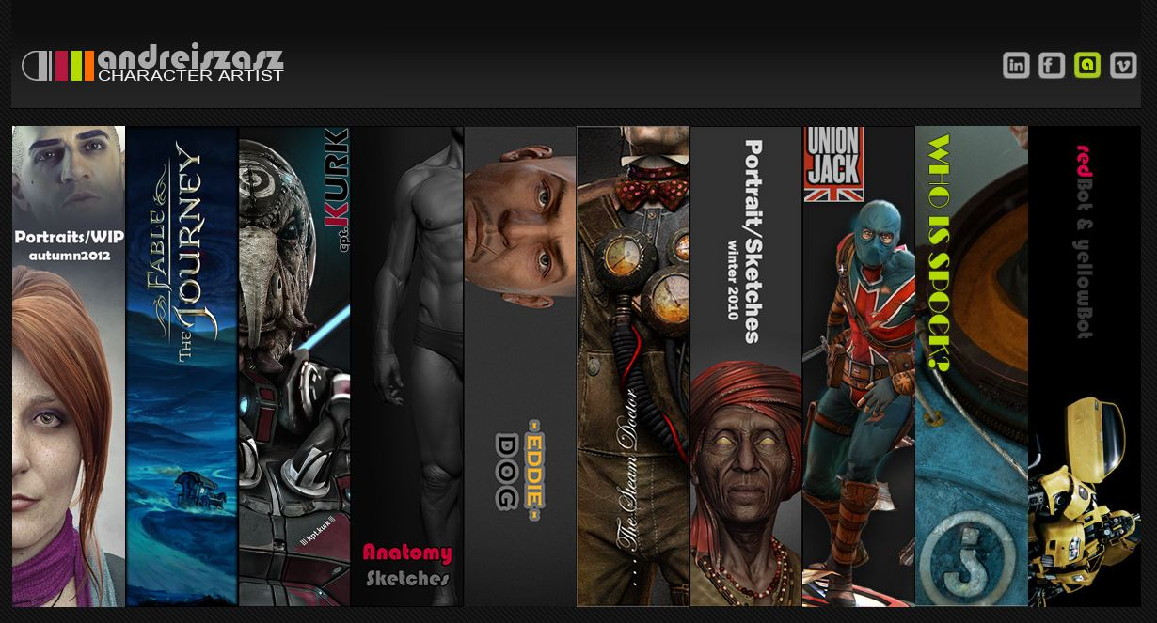
Portfolio | Websites

Slide 19
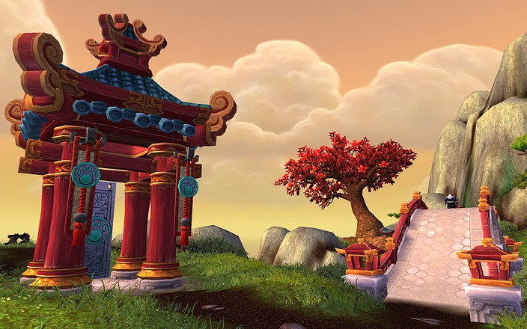
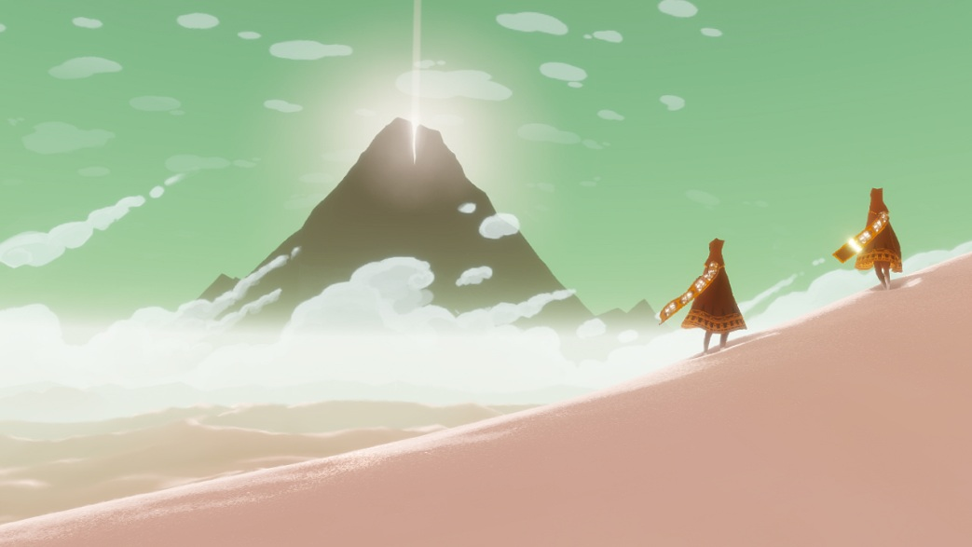
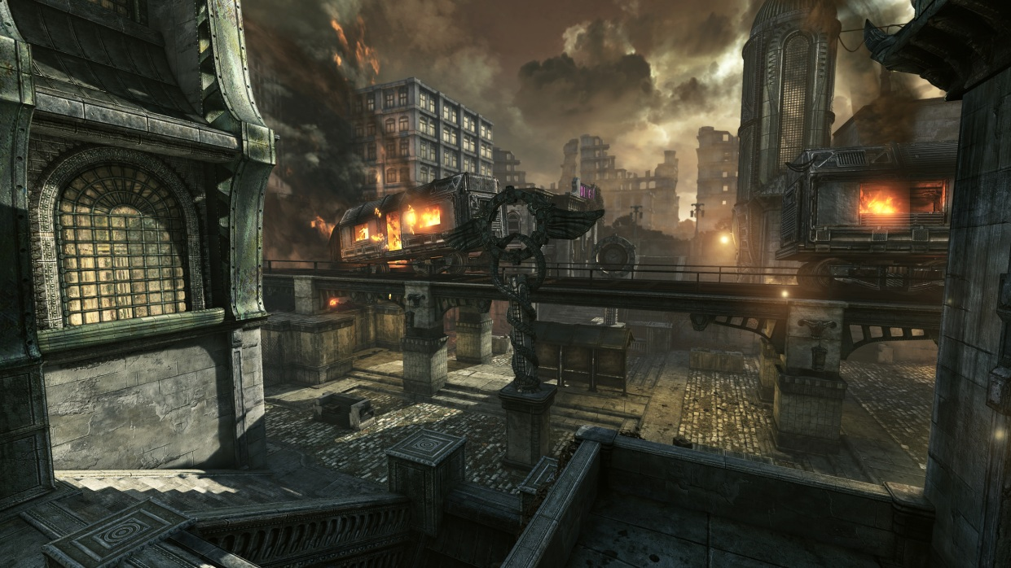
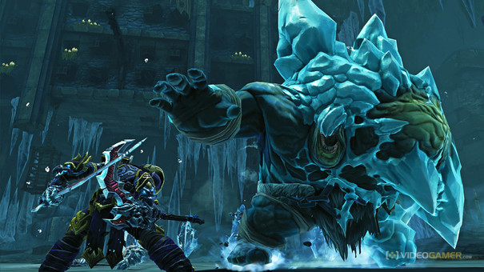
Dream Job – I want to work at . . . . .
Customizing Portfolio to fit style

Slide 20
What to expect after you have applied
Long waiting period, some companies may not get back to you immediately
You may get a Art, Design, Animation or Programming test
The Test! * Consider this test as though its going to the President * Work overtime, get little sleep * It’s your chance to prove to them if you can do the work * Complete it in the time they give you * If they have software requirements, use what is asked. Not exported from another application. * Label the file correctly, name_TestExample * Wait for a response
You may get rejected ;( OR move on in the interview process!
Don’t get discouraged!
Don’t give up!
Don’t apply only at 1 company, apply to many, increase your chances
If there no NDA for the test, post your work on a community site, get feedback, add polish and put it in your portfolio.

Slide 21
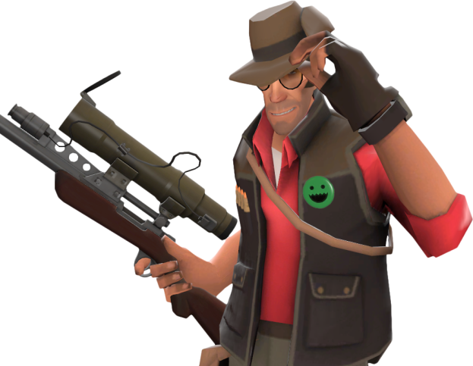
Things to know about working in developer environment.
There is no set path. Work hard! Portfolio is your ticket to success!
Learn from others in the community / join online competitions
Don’t be a jerk. It’s a team environment. You may work with the same people again.
Network, Join sites where others frequent. PolyCount | Game Artisans | CGTalk
Artists: Post your work on Polycount.com! Feedback makes you a better Artist!
There is no guarantee of stable work. Studios close, layoffs, have portfolio ready.
Always save money, be able to live within you means.
Be prepared to move / relocate
It’s a fun enjoyable career which is why so many people stay.
Always be willing to learn new software techniques. Keep yourself current.
Better to work at a company with a culture you will enjoy, rather than games they develop.
Be prepared to work overtime “crunch”. During milestones and end of project.
Try to stay healthy, reduce intake of the free snacks.

Slide 22
Important Resources
GameDevMap.com
Gamasutra, GameJobs, Creativeheads.net
Portfolio display sites: Carbonmade , wordpress, HTML, CGhub.
Polycount.com/forum ( Recommended for Artists, Character Artists, Environment Artist )
Mapcore.net ( Recommended for Designers & Scripters )

Slide 23
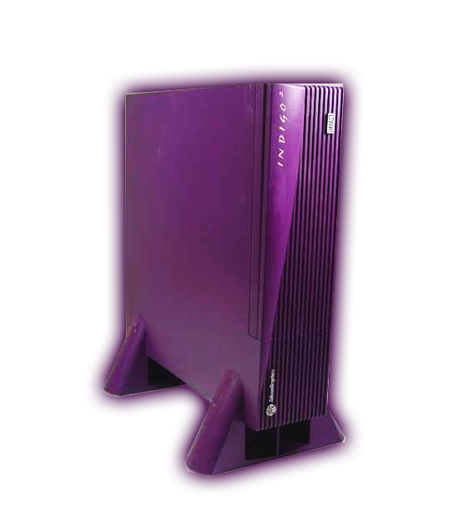
Questions?
Thank you for listening

